Slide 1
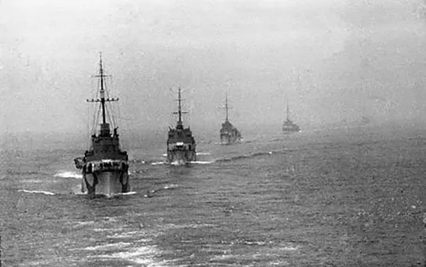
Arctic Convoys AI driven Study Materials
AI driven Study materials
Svetlana A Strinyuk, associate professor, sumis

Slide 2
Patriotism in English classes
Promoting Responsible Citizenship: From Remembrance to Action
Connecting historical lessons to contemporary issues
Encouraging civic engagement: voting, volunteering, advocacy
Study: Students who study history are 28% more likely to participate in community activities (American Historical Association, 2022)
Patriotism Redefined
Patriotism grounded in historical awareness and ethical responsibility
Empowering students to be informed and engaged citizens
Classroom Activities: Fostering Empathy and Critical Thinking
Stepping into the shoes of different characters.
Engaging in respectful discussions about controversial issues.
Expressing personal responses to war trauma.

Slide 3
Archival sources into learning materials
Types of archives
ship logs, personal diaries, official reports, intercepted communications, video reports, films, personal letters, photographs, etc
texts – videos (sound), photos
Language skills involved
Reading
Listening
Speaking
Writing

Slide 4
AI Instruments for English Teacher
GOOGLE ACCOUNT
https://twee.com/ - lessons, text generations
@GPT4Telegrambot – tasks, text generations
https://www.perplexity.ai/ - text generation, AI driven search, tasks
https://consensus.app/ - text generation, AI driven search, tasks
https://gamma.app/ - AI driven presentations, planning, text/tasks generation
https://fusionbrain.ai/ - pictures
https://ideogram.ai/ - pictures
https://web.diffit.me/ - building lessons
https://app.napkin.ai/ - visualizing data from the text – graphs, time lines
https://any2text.ru/ - video (file) into text
https://www.deepl.com/

Slide 5
Generative AI: Functionality
Text Generation: content creation
Image & Video Generation: art, design, and beyond
Audio Generation: music, speech, and sound effects
Data Augmentation & Synthesis: enhancing datasets for training

Slide 6
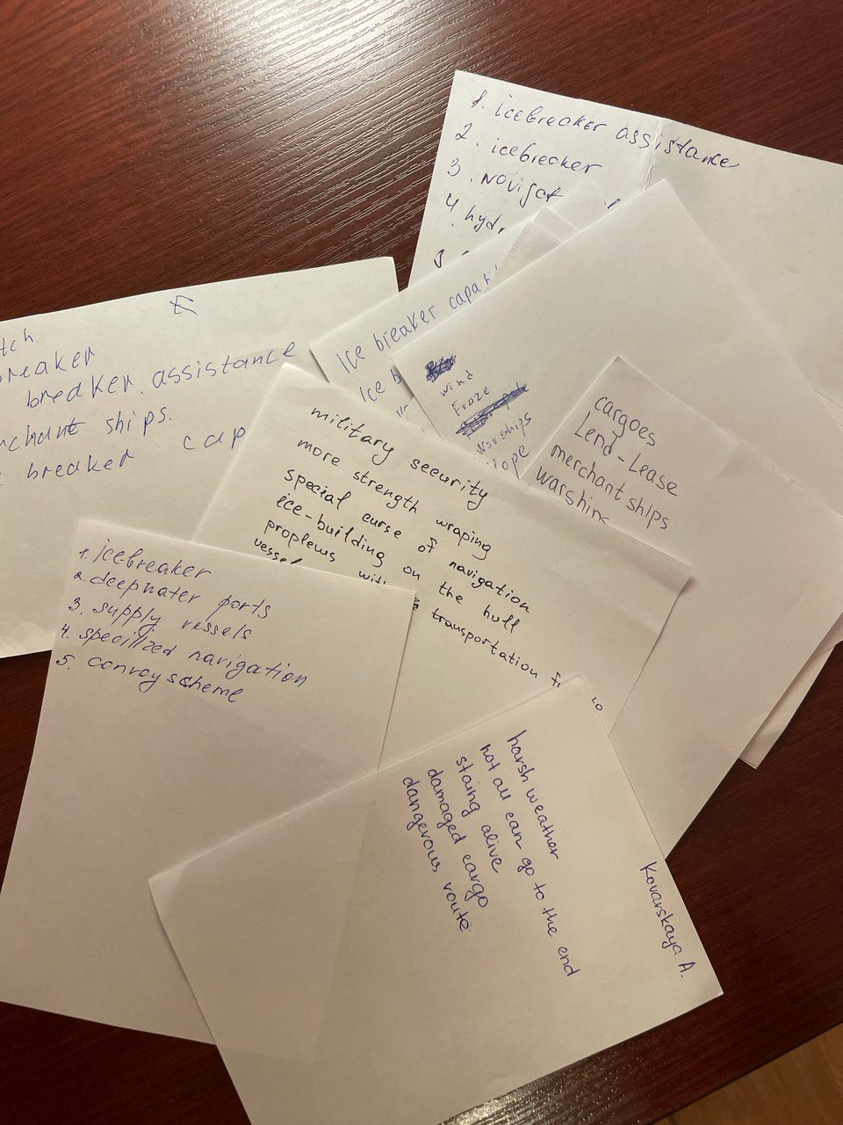
Arctic Convoys: student survey (3d year) @GPT4Telegrambot, perplexity.ai
Harsh Weather and Arctic Conditions
Icebreaker Assistance and Navigation
Ships and Convoys
Cargo and Supplies
Military Operations and Security
Geographical Locations
General Themes of Survival and Danger

Slide 7
Arctic Convoys: student survey (3d year) perplexity.ai
Harsh Weather and Arctic Conditions
Words: harsh weather (2), frost (2), frostbite (2), frozen (1), bad weather conditions (1), unfavorable weather (1), ice building of the vessel (1), icebuilding on the hull (1), frost-resistant steel (1)
Total Words: 12
Most Frequent Words: harsh weather, frost, frostbite (each mentioned 2 times)
Icebreaker Assistance and Navigation
Words: ice breaking (2), ice breaker assistance (4), ice breaker capability (2), icebreaking (2), ice breaker (3), specialized navigation (1), special course of navigation (1), hydrodynamics (1)
Total Words: 16

Slide 8
Language skills: @GPT4Telegrambot, perplexity, gamma.app
Listening
Pre-Viewing Vocabulary & Context
Identifying Key Information
Understanding Accents and Dialects
Reconstructing Events – general understanding
Inferring Meaning from Context
Focused Vocabulary Building
Dictation and Transcription
Reading Comprehension
Pre-Viewing Vocabulary & Context
General and Specific Comprehension Questions
Summarization Activities (paragraph/one sentence)
Critical Thinking Exercises (Cause and Effect Charts)
Analyzing Orders - understanding the structure and intent of various naval orders.
Deciphering Codes - learning how to interpret coded messages or abbreviations
Vocabulary Building (creating word maps and identifying collocations)

Slide 9
Language skills: @GPT4Telegrambot, perplexity, gamma.app
Writing and Composition
Report Writing - structure and language of operational reports and after-action reviews.
Descriptive Writing - techniques for vividly describing conditions at sea or in battle, photo analysis and descriptive writing
Narrative Techniques and Creative Writing - writing personal accounts or histories from the perspective of convoy participants.
Speaking
Dialogues - sailor interviews, "Experts" on the Arctic Convoys
Presentation - a specific Convoy, any aspect of Convoys, etc
Discussions - expert panels
Role plays
Video summaries
Reaction videos
Storytelling – personal stories, from photos
Podcast Creation - students create a podcast summarizing what they learned about Arctic convoys
Peer Teaching – mini lessons, teach back sessions
Radio Communication Practice - Simulating naval communication scenarios using appropriate vocabulary and phrases

Slide 10
Multimedia tasks – video/photo and reading resources: gamma.app
Historical Interpretation: Document Analysis Activity
Activity: Pair video segments with related historical documents (e.g., letters, diary entries, official reports).
Task: Students compare and contrast the information presented in the different formats.
Focus: Analyzing the perspectives of different individuals involved in the convoys (e.g., sailors, officers, civilians).
Example: Contrast the video depiction of a convoy attack with a survivor's written account.
Goal: Fosters a deeper understanding of the historical context and different perspectives. Master speaking/presenting/writing skills with the language focus – contrasting and comparing grammar aspects - or vocabulary expressions

Slide 11
Language focus: @GPT4Telegrambot, perplexity, gamma.app
Vocabulary Topics
Naval Terminology – terms specific to naval operations, including ranks, ships, and equipment, ship types and functions (destroyers, cargo/merchant ships).
Technical Language - understanding technical specifications and operations of naval equipment.
Survival Language - vocabulary related to survival tactics and safety measures in extreme conditions.
Weather Vocabulary - terms related to Arctic weather conditions (e.g., blizzards, icebergs, fog)
Supply Chain and Logistics - terms related to cargo, transport, and supply routes
Communication Protocols - vocabulary used in naval communication, including codes and signals
Emergency Procedures - terms related to distress signals and emergency protocols
Geographical Terms - names of key locations, routes, and geographical features relevant to the convoys

Slide 12
Language focus: @GPT4Telegrambot, perplexity, gamma.app
Grammar Topics
Tense Usage and Sequence of Tenses - different tenses used in historical reporting
Passive Voice - usage of passive constructions in reports and descriptions of actions taken
Conditional Sentences - understanding hypothetical situations in operational orders
Reported Speech - how to convey orders and messages from one source to another
Imperative Sentences - commands and instructions found in orders and communications

Slide 13
twee.com

Slide 14
Limitations of youtube and viable solutions to smooth out the problems
1. Interview https://www.youtube.com/watch?v=DzT9QdZlMow
task 1: to get the video
solution: use this link: https://ssyoutube.com/
task 2: to get the script of the video
challenge: PRO script of twee
solution: under the video in «еще» menu get youtube script расшифровка видео – показать текст видео – (в правом верхнем углу экрана) – показать или скрыть временные метки
result: no punctuation marks, short lines:
good comrade ship right from the
beginning The Men Who were on board
welcome me come on Brommie have some BR

Slide 15
Limitations of youtube and viable solutions to smooth out the problems
task 3: to make a script (to use in twee, to have the basis for exercises, etc)
solution: @GPT4Telegrambot
prompt: please divided this text into sentences and place punctuation marks:
good comrade ship right from the
beginning The Men Who were on board
welcome me come on brommie have some BR
how did I know I'm from
Birmingham
result:
Good comrade, ship right from the beginning. The men who were on board welcomed me. "Come on, Brummie, have some beer." How did I know? I'm from Birmingham.

Slide 16
Reading skills: consensus.app, twee.com, @GPT4Telegrambot
consensus: abstract: A Very Different Experience: Merchant Seamen on British Coastal Convoys 1940-45‘ Published 2018 · G. Bennett
Twee: ask open questions
How have academic and public understandings of the war at sea in Europe been dominated since the early 1940s?
What impact did the British Government's decision in 2012 to award veterans of the Russian convoys a special campaign medal have on public perceptions of the geographical confines of Britain's sea war?
GPT: rewrite the text for maritime B1 students; ask 10 questions
What has dominated academic and public understandings of the war at sea in Europe since the early 1940s?
How are U-boats and merchant ships typically represented in media narratives about the Atlantic convoys?

Slide 17
Reading skills: @GPT4Telegrambot
Prompt: please suggest vocabulary exercises to learn words from this text. Identify topic groups of words.
Exercise 4. Read the text carefully and group the following words into categories: Weather, Ship Movement/motions, Ship Parts, Safety Equipment, and Nautical Terms.
“The gale force winds cut through to your bones, we ploughed through, but in the Arctic, east of Bear Island, the sea channels were very narrow we had to go east with NO deviation.
The weather caused tremendous problems with fierce and unforgiving storms. The Orwell was rolling as much as 30 degrees to port and starboard. We had to use lifelines when going aft... These lifelines were fitted very firmly and anyone going aft on deck had to have a fixed lifeline around his body with a hook on to the lifeline and then gradually inch their way aft when the ship was steady. For when she (the Orwell) rolled over your feet left the deck and at 30 degrees you were hanging above the sea”
Answers: gale, lifeline, port(side), storm, aft, roll, starboard, (no)deviation, hook, sea channels, steady, deck

Slide 18
Listening skills: Able Seaman Albert Malin twee.com
Exercise 1. Watch the video and answer the question
1. How did the narrator feel when he first joined the ship?
2. What was the narrator's experience during the severe storm in the Arctic?
Exercise 2. Match the items in Column A with the correct items in Column B to form meaningful collocations. Write the letter of the correct match next to each number
Exercise 3. Fill in the gaps with the collocations
We hit one of the worst storms the Arctic had ever had, and this is where I soon found my sea legs. A Corvette, 900 tons, and we had 92 men on board, 1. _____. While I was on lookout, I was 2. _____, and I 3. _____to a rail. With the seas 4. _____ us and freezing water running down inside my clothes, my boots were full of water.
A |  | B
1 | to toss about | A | the upper deck
2 | to tie with | B | like a cork
3 | the starboard | C | lookout

Slide 19
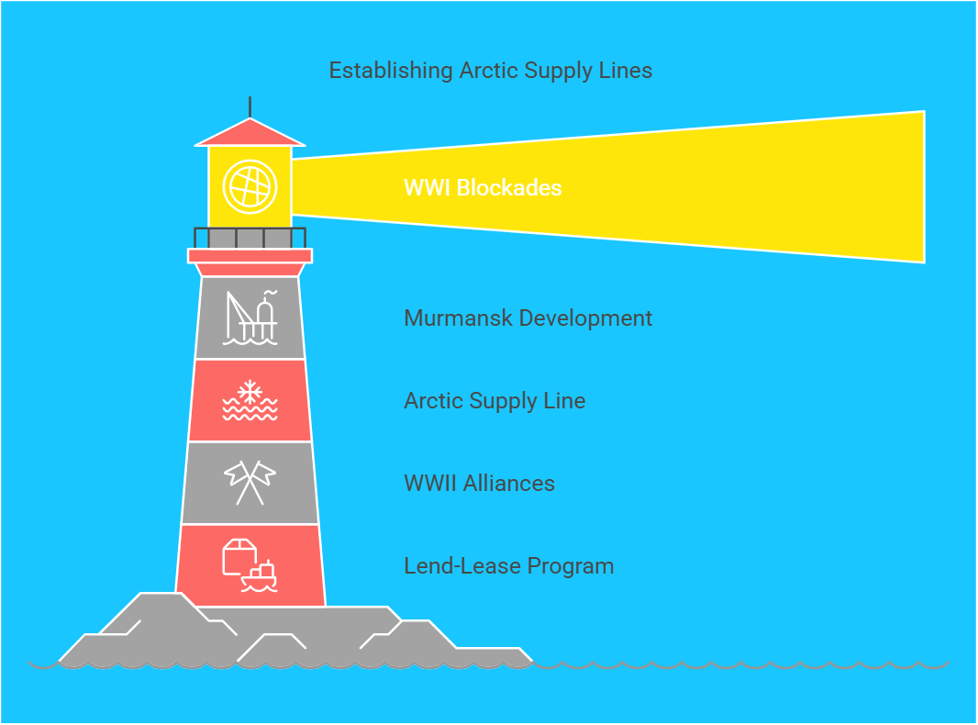
Text visualization https://app.napkin.ai/
https://en.wikipedia.org/wiki/Arctic_convoys_of_World_War_II
text containing a lot of dates and events

Slide 20
Listening skills: @GPT4Telegrambot
Take notes on key points, including the strategic importance of the convoys, challenges faced by sailors, and notable events. After listening, summarize the episode in your own words and discuss it with a partner or group to reinforce comprehension.
Documentary Viewing: Watch a documentary about the Arctic convoys and focus on the audio elements, such as interviews with veterans, narration, and sound effects. Create a list of specific terms or phrases related to the topic that you hear. Afterward, research those terms and present your findings to a class or study group.
Listening Comprehension Exercise: Find an audio recording of a historical account or firsthand testimony related to the Arctic convoys. After listening, answer comprehension questions that test your understanding of details such as dates, locations, and personal experiences shared in the recording. This can be done individually or in pairs.
Role-Playing Discussion: Listen to a series of recorded interviews with historians or veterans discussing their experiences with Arctic convoys. Afterward, engage in a role-playing exercise where you take on the persona of one of the speakers and discuss their perspective on the events. This task encourages active listening and empathy.

Slide 21
Listening skills: @GPT4Telegrambot
Prompt: please select the words meaning parts of ships from this text and make a filling the gap exercise with them. Provide answers
Exercise 3. Fill in the gaps with the appropriate words from the list below.
bridge party sister ship harbour Greenock ship lookout
Gradually, you sort of got used to these conditions, and I became quite an expert at carrying mugs of tea on the rolling 1. _______ up to the 2. ________, much to the relief of the officers in charge up there. Suddenly, the officer in charge leaned over to me on the bridge and said, "Keep an extra 3. ________." Ming the Blue Bells was our 4. ________, and she had 92 men on board, the same as we did.

Slide 22
Speaking tasks - @GPT4Telegrambot
Prompt:
Please create three speaking exercises for maritime students to use verb-noun, noun-verb and adjective-noun collocations on the Arctic Convoys, for example "supply arrives, escort convoys, weather worsens”, etc
Speaking 1
In pairs, take turns completing the sentences using the correct verb-noun collocations.
Speaking 2
Discussion Points:
- Why was it critical to supply goods to the Soviet Union?
- What challenges did ships face while navigating in the Arctic?
Use collocations:
Speaking 3
In small groups, create sentences using the following noun-verb collocations. Each group should present their sentences and explain their relevance to the Arctic Convoys.

Slide 23
Images into speech: perplexity, Kandinsky, ideogram,
describe the picture (grammar and vocabulary focus)
or describe one of the situations you think may arise during the Arctic Convoys (grammar and vocabulary focus); use ideogram.ai or any AI image app to generate the image; share it with a partner and discuss whether the image adequately represents the situation

Slide 24
Images into speech: perplexity, Kandinsky, ideogram,

Slide 25
@GPT4Telegrambot for grammar
prompt: please make three report speech exercises nine sentences in each for marine students learning English. Make exercises of different types
result:
Exercise 1: direct into indirect: Instructions: Change the following direct speech sentences into indirect speech.
The captain said, "We will set sail at dawn."
The engineer told me, "I need to check the engine before we leave."
The navigator said, "We have to adjust our course to avoid the storm.“
Exercise 2: Mixed Reported Speech Instructions: Rewrite the following sentences in reported speech, mixing statements, questions, and commands.
The crew member inquired, "When will we reach the next port?
The captain reminded us, "Always wear your life jackets while on deck."
The navigator asked, "Did you check the tide schedule?"
The engineer requested, "Please pass me the wrench."
The lookout shouted, "There’s a vessel on our starboard!”
Exrcise 3:
The captain said (explained) that they would be navigating through rough seas.
The engineer said (suggested) that they should conduct a full inspection of the equipment.
The first mate said (warned) that they needed to be cautious of strong currents.
The crew member said (admitted) that he was feeling seasick.

Slide 26
gamma.app
https://gamma.app/
paste in text
generate (400 credits, 40 for a presentation)
import file or URL
Create new AI (outline)
creates eight cards
content may vary
Prompts (enquiries)
Learning all past tenses and passive voice for b1 marine students on Arctic Convoys in ww2
Speaking tasks using all past tenses and past passive on Arctic Convoys in ww2 for marine students learning English b1
Eight communicative situations for mini presentations in groups of three marine students on Arctic Convoys in ww2
Vocabulary lesson on handling equipment and packaging used in Russian ports in ww2 to discharge Arctic convoys vessels for maritime students. offer 35 ESP words

Slide 27
Grammar lesson for B1 maritime students on Arctic Convoys: past simple, past perfect active and passive. Offer exercises (gap filling, open the brackets, matching) with the answers
Past Simple: Review & Context
Definition: Actions completed in the past.
Form: Regular verbs (+ed), irregular verbs (2nd form).
Arctic Convoys Example: "The convoy sailed from Iceland in December 1941."
Fact: Convoy PQ 7B, mentioned above, lost 7 ships out of 19.
Exercise 1 (Gap Fill): Complete the sentences with the past simple form of the verb.
The ships ____ (carry) vital supplies to the Soviet Union.
German U-boats ____ (attack) the convoys relentlessly.
Many sailors ____ (brave) the freezing conditions.
Answer key: carried, attacked, braved

Slide 28
Grammar: gamma.app 1. Imperative Mood & Instructions:
Language focus: Orders, directives, and operational instructions found in naval communications.
Examples:
"Maintain radio silence unless under attack."
"Increase speed to 15 knots immediately."
"Report any sighting of enemy vessels."
Exercise type: Transforming statements into commands, rewriting unclear instructions for clarity, identifying the subject/agent of the imperative.
Example archive material: "Signal Book for the Use of All Ships at Sea" (pre-war naval signals) and convoy operational orders (ADM series).

Slide 29
Grammar: gamma.app 2. Reported Speech & Narrative Accounts
Focus: Analysing eyewitness accounts and official reports, transforming direct speech into reported speech.
Examples:
Original diary entry: "We sighted a U-boat at 0600 hours. The Captain ordered full speed ahead."
Reported speech exercise: "The diarist wrote that they had sighted a U-boat at 0600 hours and that the Captain had ordered full speed ahead."
Exercise type: Summarising narrative accounts, identifying bias, transforming direct quotes into indirect speech, and analysing the tense changes involved.

Slide 30
Grammar: gamma.app 3. A 3d conditional
prompt: third conditional on the topic Arctic Convoys. Transforming general statements about the importance of the Arctic Convoys into the third conditional sentences. Make various exercises and provide answers
Convert the following statements about the Arctic Convoys into third conditional sentences.
"The Arctic Convoys were vital for sustaining the Soviet war effort."
"The convoys helped the Soviet Union withstand the German invasion."
"These missions demonstrated Allied solidarity against Nazi Germany."
"The supplies delivered were essential for Soviet military production.“
Answers
If the Arctic Convoys hadn't been vital for sustaining the Soviet war effort, the outcome of the war might have been different.
If the convoys hadn't helped the Soviet Union withstand the German invasion, Germany might have advanced further into Soviet territory.
If these missions hadn't demonstrated Allied solidarity against Nazi Germany, the alliance might have been weaker.
If the supplies delivered hadn't been essential for Soviet military production, the Soviet Union might have had difficulty fighting the Germans.

Slide 31
Grammar: gamma.app 3. B 3d conditional
Instructions: Complete the following sentences using your own ideas in the third conditional. Think about the challenges of the Arctic Convoys (weather, attacks, etc.)
If the ice conditions had been even more severe,...
If the Allied navies had not provided escorts,...
If the Soviet Union had not received these supplies,...
Possible Answers:
If the ice conditions had been even more severe, many ships would have been forced to turn back or been crushed.
If the Allied navies had not provided escorts, the convoys would have been extremely vulnerable to U-boat attacks.
If the Soviet Union had not received these supplies, they would have struggled to equip their armies and defend their territory effectively.

Slide 32
Collocations: perplexity
prompt 1 the most significant collocations used in the Arctic convoys
Arctic Convoys
Allied Support
Soviet Union
World War II
Merchant Navy
Naval Escort
Air Cover
Icebreaker Escorts
Radio Silence
Convoy System
PQ Convoys (outbound)
QP Convoys (homebound)
prompt 2: 30 verb-noun, noun-verb and adjective-noun collocations on the Arctic Convoys
Verb-Noun Collocations
to escort convoys - to protect convoys with warships.
to avoid icebergs - to steer clear of floating ice hazards.
to report sightings - to inform command of enemy observations.
Noun-Verb Collocations
escorts accompany - warships traveling with merchant vessels for protection.
weather worsens - conditions becoming more severe.
supplies arrive - goods reaching their destination.
Adjective-Noun Collocations
severe weather - extreme meteorological conditions.
close formations - tight groupings of ships for safety.
critical supplies - essential goods being transported.

Slide 33
Vocabulary Exercise: Code Names & Euphemisms gamma.app
Prompt: please give examples of Code Names & Euphemisms in Arctic Convoys communication
Focus: Deciphering coded language and understanding indirect references.
Examples:
Code names: "Operation Dervish" (first convoy), "PQ" and "QP" series.
Euphemisms: "Lost with all hands" (killed in action), "incident" (attack by enemy forces), "unserviceable" (damaged or destroyed).
Exercise type: Decoding messages, identifying the true meaning behind euphemisms, explaining the strategic reasons for using code.
Source examples: Decrypted Enigma messages (available at Bletchley Park archives), convoy situation reports.

Slide 34
Task Assessment Criteria: perplexity.ai
Prompt: Please create speaking task assessment criteria: discussion question on arctic convoys
1. Content (40 marks)
Historical Context (10 marks): Ability to describe the background and purpose of the Arctic Convoys.
Strategic Importance (10 marks): Understanding of how the convoys supported the Soviet Union and affected the war on the Eastern Front.
Challenges Faced (10 marks): Discussion of the dangers and difficulties encountered by the convoys, including weather conditions and enemy attacks.
Impact on the War Effort (10 marks): Explanation of how the convoys influenced the outcome of World War II.
2. Communicative Competence (30 marks)
Fluency (10 marks): Ability to speak smoothly and naturally without frequent pauses.
Pronunciation (5 marks): Clarity and accuracy of pronunciation.
Engagement in Dialogue (10 marks): Participation in the discussion, responding to questions, and engaging with other participants.
Logical Consistency (5 marks): Ability to present ideas in a coherent and logical manner.
3. Language Use (30 marks)
Vocabulary (15 marks): Use of appropriate and varied vocabulary related to the topic.
Grammar and Syntax (10 marks): Correct use of grammatical structures and sentence formation.
Idiomatic Expressions (5 marks): Use of idiomatic expressions or phrasal verbs relevant to the topic.

Slide 35
Speaking/writing assessment Chat GPT
Writing - text
Speaking – text
Upload to chat GPT
Prompt: please assess this answer against the criteria (…). Make suggestions how to improve the answer.

Slide 36
Writing tasks: perplexity.ai
Prompt: Please make a list of writing tasks based on Arctic Convoys WW2
Creative Writing - "Voices from the Arctic"
Objective: Encouraging creative expression and deeper engagement with historical material.
Activity: Students write fictional diary entries, poems, or short stories from the perspective of someone involved in the Arctic Convoys.
Roles: Sailor, captain, nurse, civilian, or even a historical figure.
Emphasis: Historical accuracy, emotional depth, and vivid descriptions.
Example: A diary entry from a young sailor on his first convoy, expressing his fears, hopes, and experiences.
Sharing: Students share their creations in class.

Slide 37
Text to speech https://ttsmaker.com/
https://ttsmaker.com/
number of characters limitations
several speakers – memoirs
https://arcticconvoymuseum.org/veterans/john-jack-shirley/
check and select voices
files can be unloaded
use AI tools to prepare exercises

Slide 38
Study materials https://web.diffit.me/
write proper material description
worksheets are created automatically
PDF, google slides, google classroom, etc

Slide 39
Archive materials
http://vandwdestroyerassociation.org.uk/HMS_Walker/Arctic%20Convoys-1.html
https://warfarehistorynetwork.com/article/the-murmansk-run-running-the-gauntlet-of-wwiis-arctic-convoys/
https://arcticconvoymuseum.org/history-learning/what-were-the-arctic-convoys/

